Slide 1


SMART INDIA HACKATHON 2024
TITLE PAGE
Problem Statement ID – 1742
Problem Statement Title-Standardizing Odd School Structures to Improve Educational Policy Implementation and Resource Allocation
Theme-Smart Automation
PS Category- Software
Team ID- 5055
Team Name – TECH SAMURAIS

Slide 2
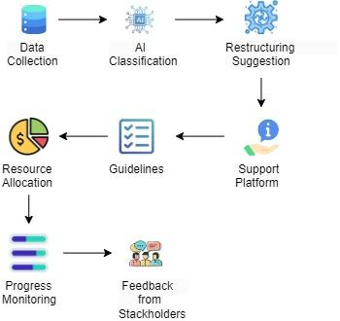
IDEA TITLE
TECH SAMURAIS
Continuous AI Improvement Process
DESCRIPTION :
Standardize odd school structures for uniform policy implementation, equitable resource allocation, and improved education quality across schools.
Solution | Working | Benefits
AI Classification Tool | Analyze school data for classification and restructuring options. | - Streamlines process. - Identifies needs.
Support Platform | Provide guidelines and resources for schools transitioning. | - Structured support. - Knowledge sharing.
Dynamic Resource Allocation | Allocate resources flexibly based on needs during transition. | - Addresses specific needs. - Promotes fairness.
Progress Monitoring Dashboard | Monitor transition progress in real-time for insights. | - Tracks changes. - Enables timely interventions.
Stakeholder Engagement Portal | Engage stakeholders through forums and feedback tools. | - Inclusive participation. - Addresses local concerns.
Uniqueness of Solution
AI-Powered Dynamic Systems: Automates school restructuring and tailors resource allocation to meet specific institutional needs.
Real-Time Monitoring: Enables continuous tracking of progress and outcomes, ensuring timely adjustments and interventions.
Collaborative Engagement Portals: Fosters inclusive community participation, allowing stakeholders to contribute feedback and insights throughout the transition process.

Slide 3
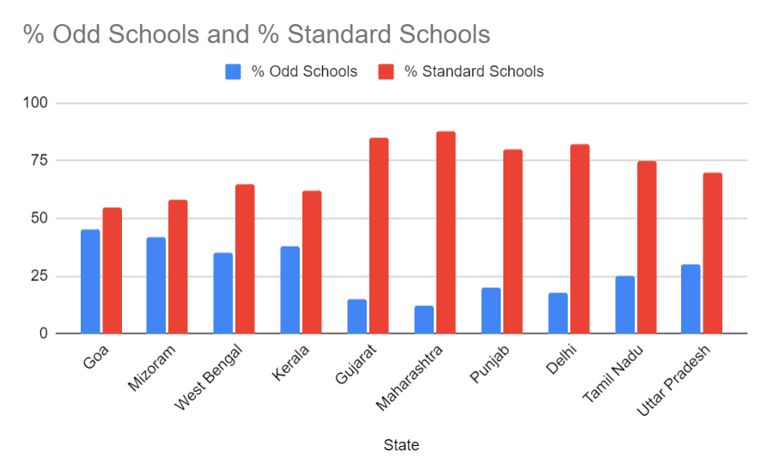
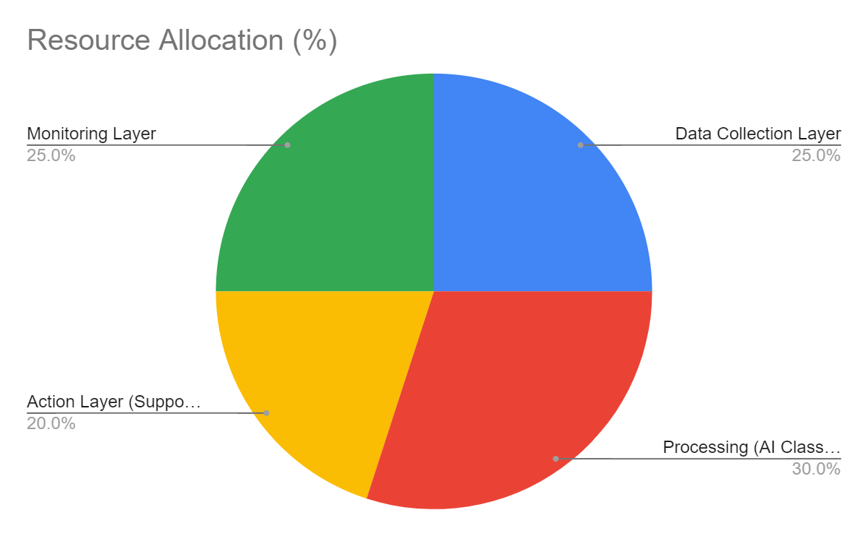
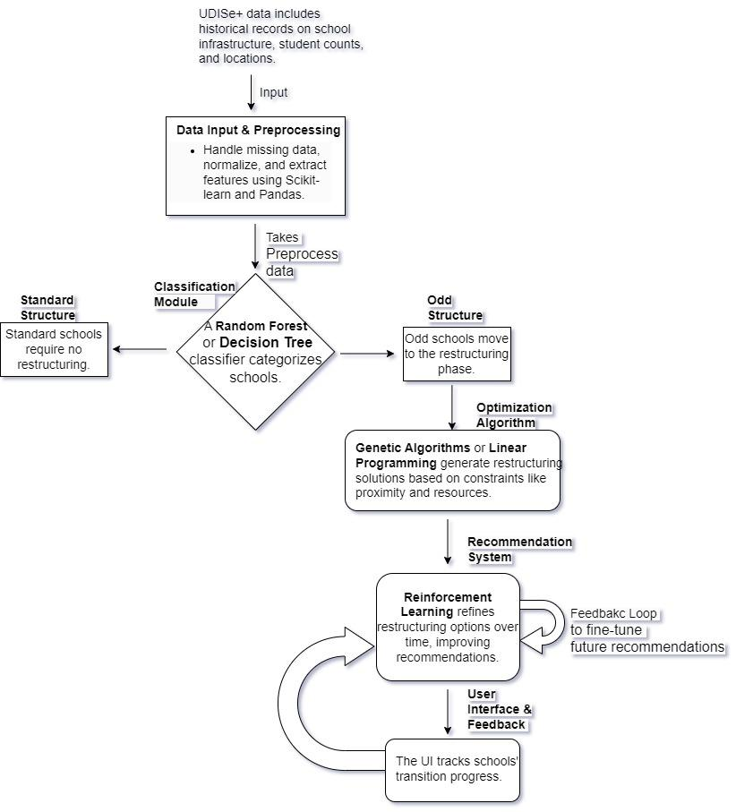



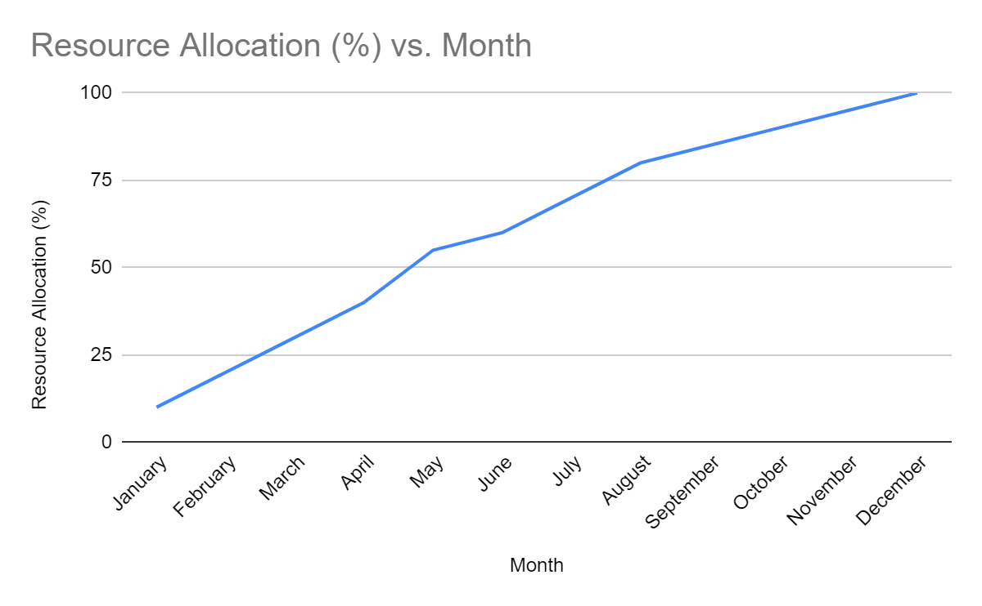


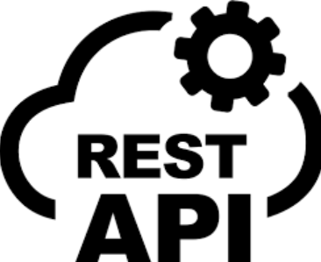




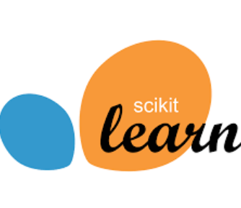
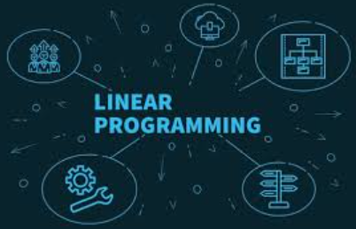
TECHNICAL APPROACH
TECH SAMURAIS
School Type Distribution by State
Resource Allocation by Layer
School Classification & Restructuring Process
Resource Allocation(%)
Monitoring Layer
Data Collection Layer
25%
25%
Action Layer
20%
Processing (AI class)
30%
Tech Stack
Frontend :
Backend :
Database :
Machine Learning :
Resource Allocation Metrics

Slide 4
FEASIBILITY AND VIABILITY
TECH SAMURAIS
Feasibility Analysis
Technical: Scalability issues, security vulnerabilities, maintenance complexity. | Technical: Agile development, risk mitigation planning, diversification.
Financial: Funding availability, economic uncertainty, cash flow management. | Financial: Cost control, revenue diversification, financial modeling.
Market: Changing consumer preferences, regulatory hurdles, competitor response. | Market: Market research, partnerships, adaptability.
Operational: Supply chain disruptions, employee retention issues, data management problems. | Operational: Process optimization, continuous improvement, contingency planning.
Challenges
Solutions
Technical: Assess hardware,
software development, integration
challenges.
Financial: Evaluate startup costs, operational expenses, revenue projections.
Market: Identify target audience, competitive landscape, potential partnerships.
Operational: Determine staffing needs, supply chain management, quality control.

Slide 5


IMPACT AND BENEFITS
TECH SAMURAIS
IMPACTS
BENIFITS
Improvement:
Enhanced educational quality
Policy implementation.
Economical:
Cost-effective resource allocation
Potential savings.
New Opportunities:
Increased access to educational resources and support.
Social Benefits:
Greater equity
Inclusivity in education.
Social:
Improved Access: Standardized educational resources for all.
Reduction: Less educational disparity and inefficiency.
Equitable Access: Standardized educational resources reduce disparities, ensuring equal opportunities for all.
Economic:
Productivity: Efficient resource allocation.
Cost: Savings from optimized distribution.

Slide 6
REFERENCES
TECH SAMURAIS
Kimball, Ralph, and Margy Ross. The Data Warehouse Toolkit: The Definitive Guide to Dimensional Modeling. 3rd ed., Wiley, 2013.
Elmasri, Ramez, and Shamkant B. Navathe. Fundamentals of Database Systems. 7th ed., Pearson, 2016.
Longley, Paul A., et al. Geographic Information Systems and Science. 4th ed., Wiley, 2015.
Few, Stephen. Information Dashboard Design: Displaying Data for At-a-Glance Monitoring. 2nd ed., Analytics Press, 2013.
FAO Fisheries and Aquaculture Department. The State of World Fisheries and Aquaculture 2020: Sustainability in Action. FAO, 2020.
Steiniger, Stefan, and Geoffrey J. Hunter. "The 2012 Free and Open Source GIS Software Map – A Guide to Facilitate Research, Development, and Adoption." Computers, Environment and Urban Systems, vol. 39, 2013, pp. 136-150.
Sheppard, Stephen A., et al. "Fisheries Monitoring and the Use of Advanced Data Analytics in a Digital Era: A Review and Synthesis." Frontiers in Marine Science, vol. 8, 2021, Article 678901.

